Slide 3
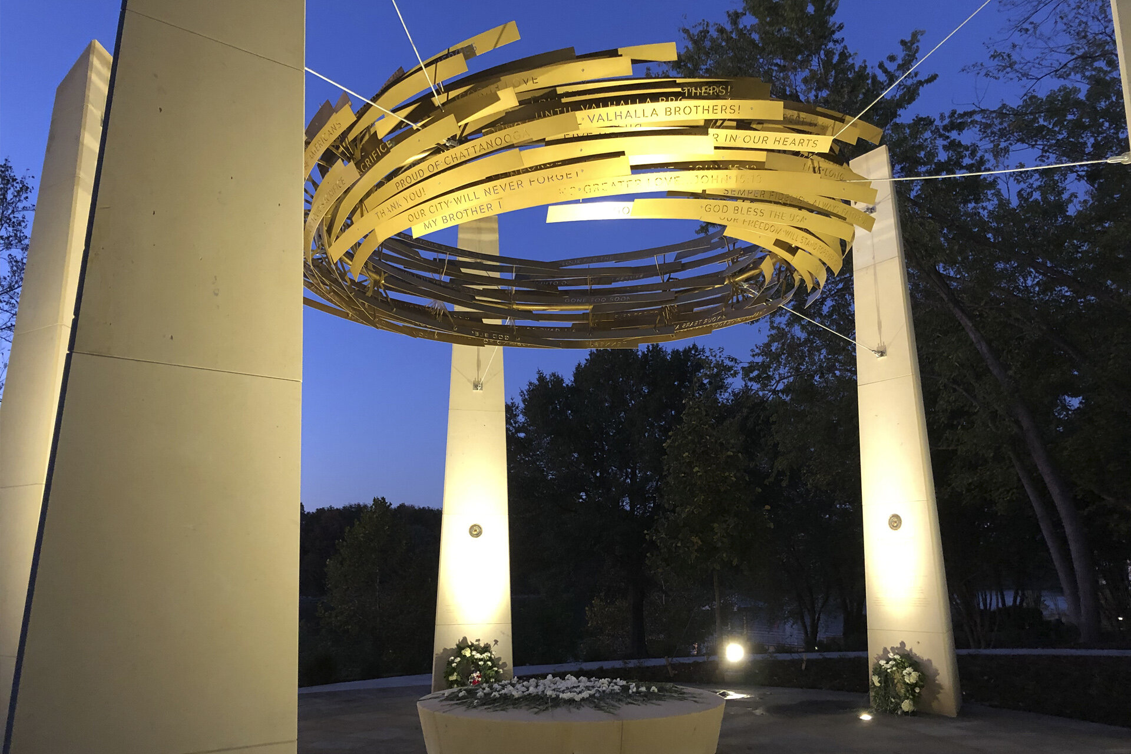
Norman Lee
www.resite-studio.com | Houston TX

Slide 4
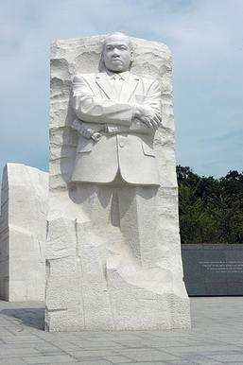
Humanity Award Public Team
www.aiqiuhopen.com | Sutton, WV

Slide 5
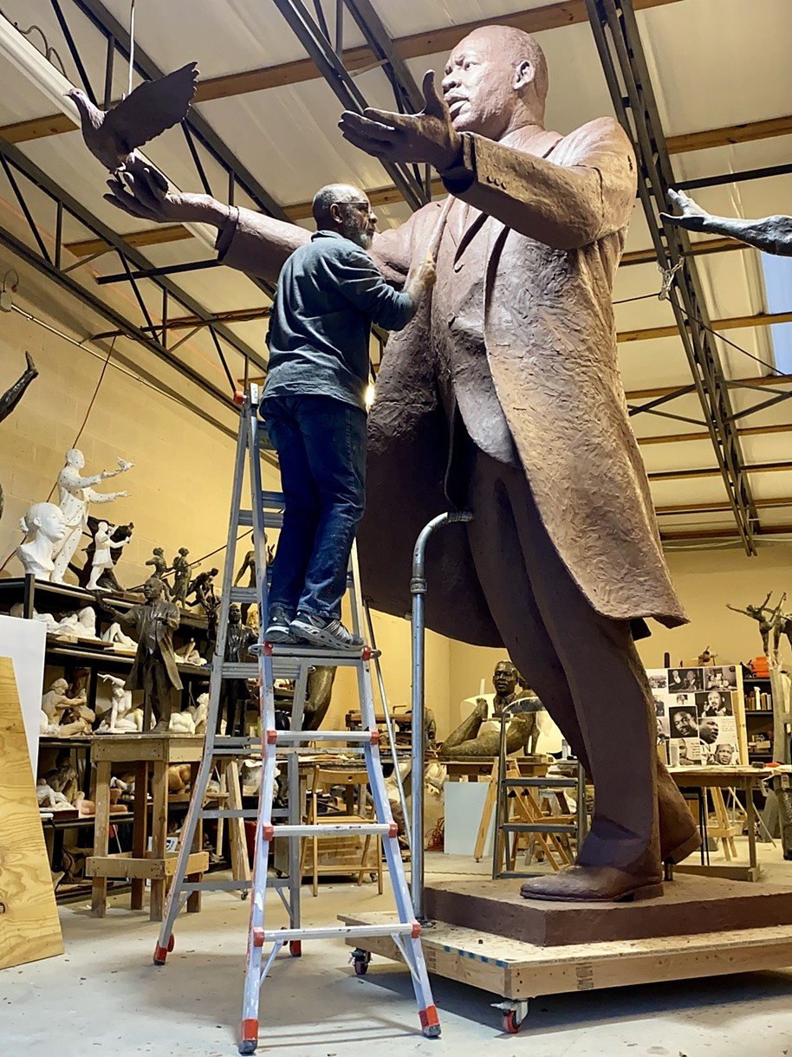
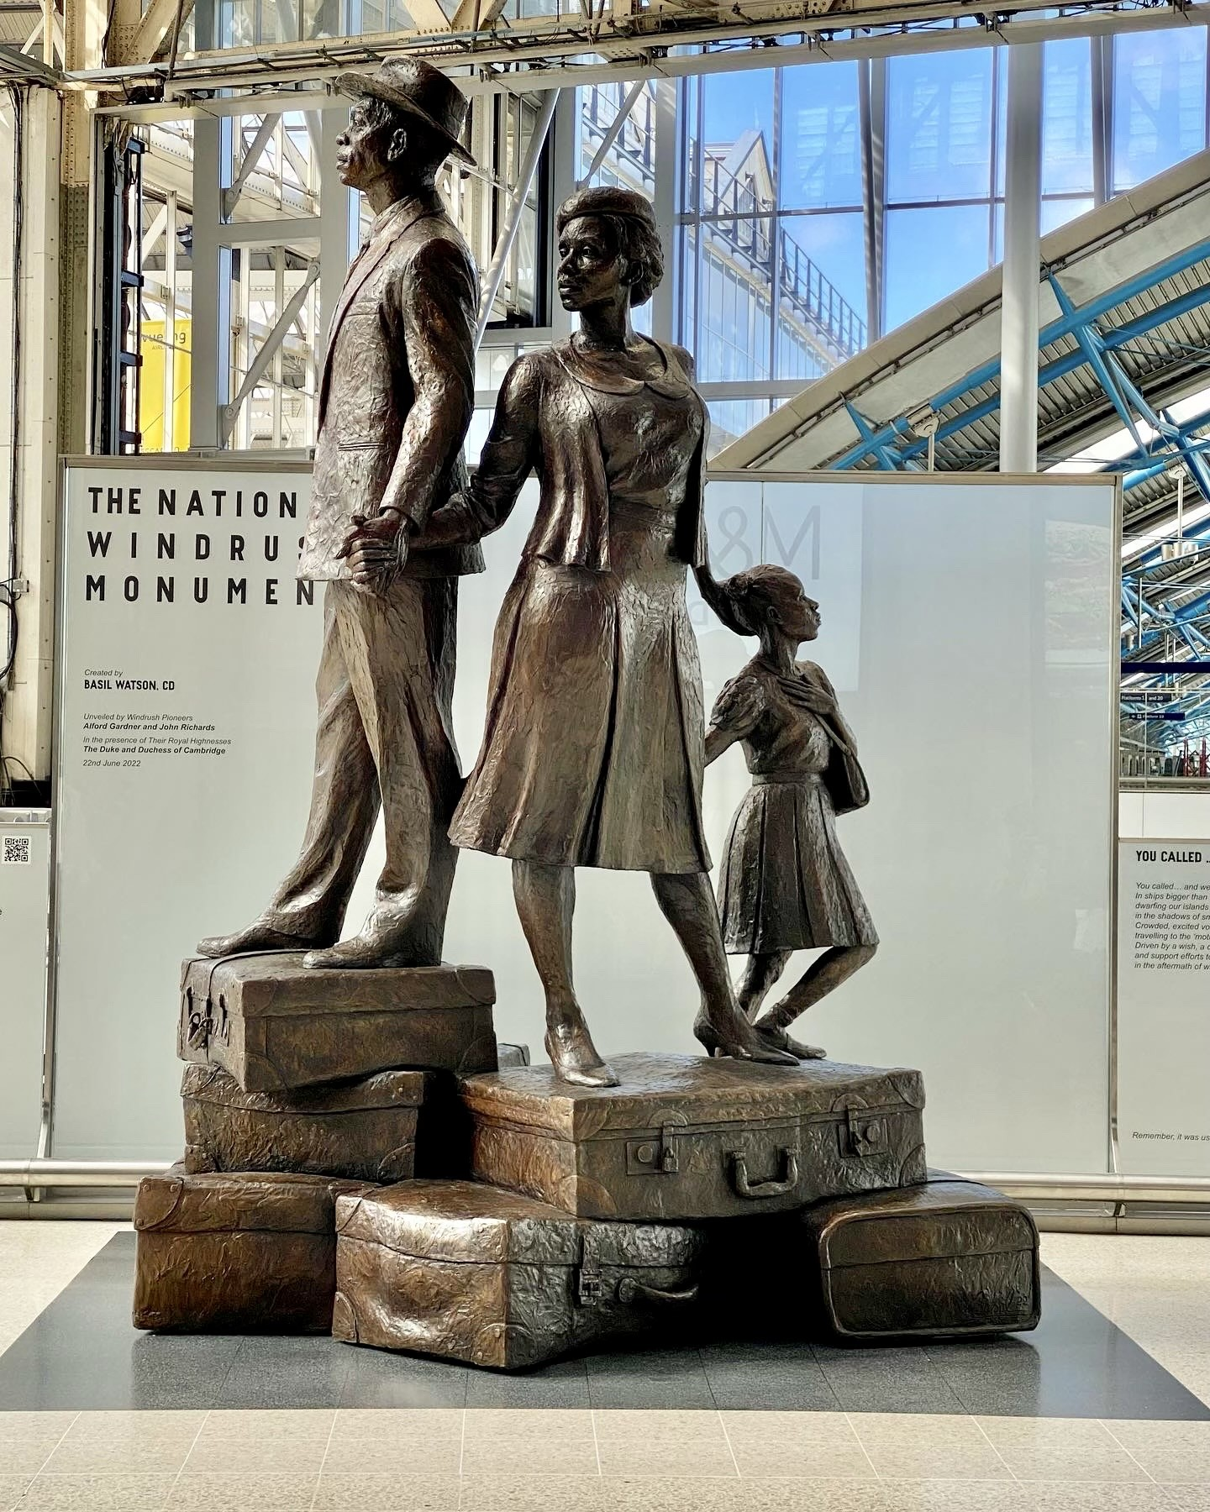
Basil Watson
www.basilsculpture.com | Lawrenceville, GA

Slide 6
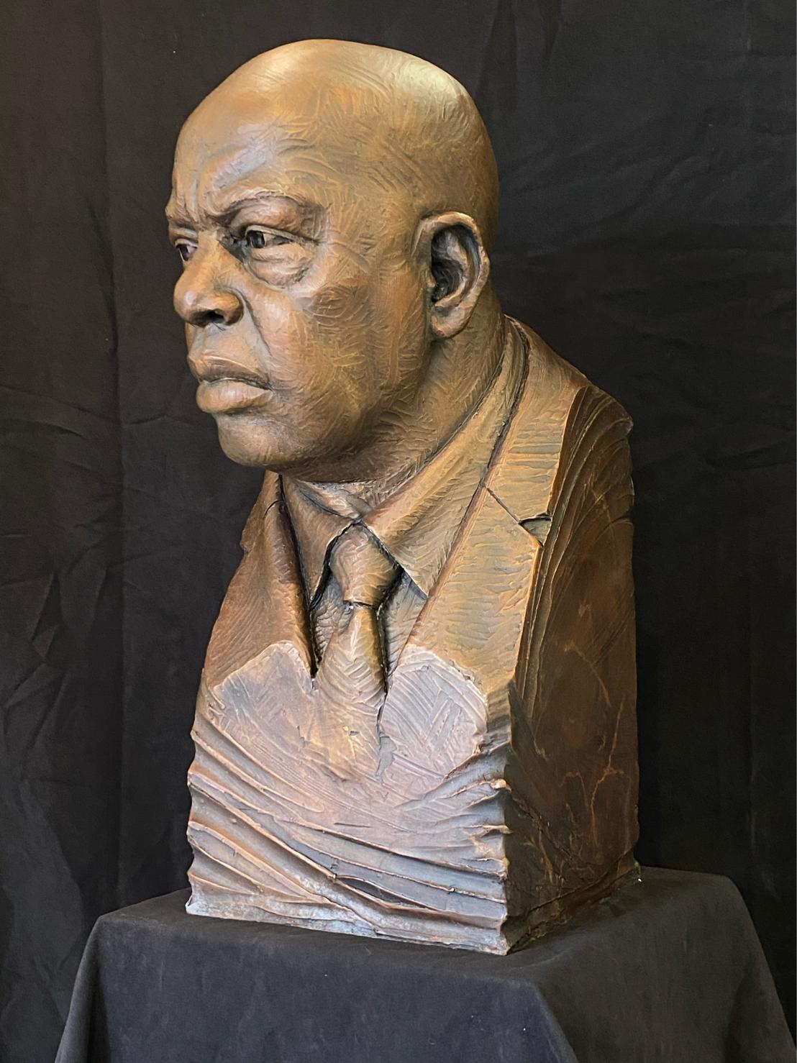
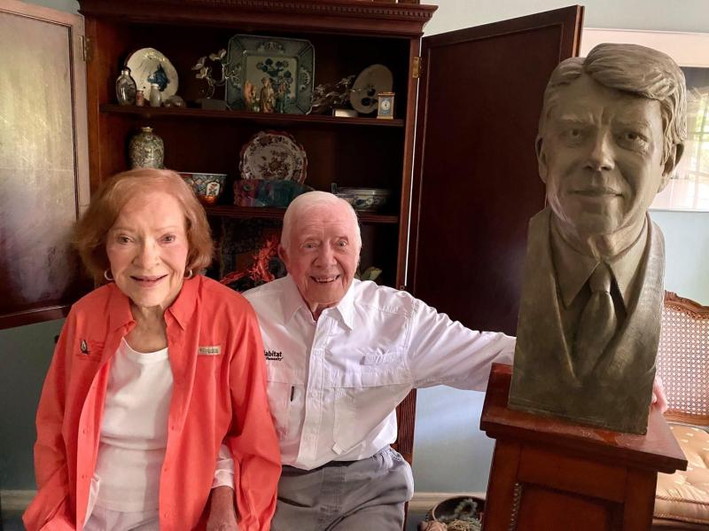
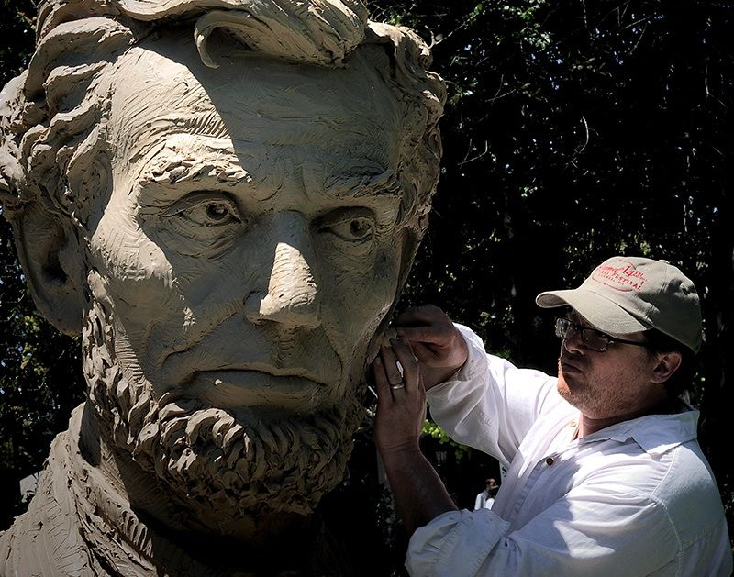
Steven Whyte
www.stevenwhytesculptor.com | Carmel-by-the-Sea, CA

Slide 7
Art Selection Process
Members of the Art Selection are Frank X Walker, Maury Sparrow, Garry Bibbs, Larry Kezele (Chairman) and Yvonne Giles. Nathan Zamarron is the Facilitator.
Step 1: Request for Qualifications (RFQ):
October 2023: RFQ received
LexArts team chooses qualifying candidates
Arts Selection Committee will score applicants.
After individually scoring candidates, the Art Selection Committee meets to choose 10+ candidates.
In the interest of openness and fairness, the 10 finalists’ information will be available for the full committee to review. The full committee will be privy to the scoring comments and can register comments.
Step 2: Art Selection Committee completes a thorough review of the 10 finalists.
The top four applicants were chosen representing varied sculpture styles.
After a review by the full committee, comments are recorded.
After further review, December 2023 the Art Selection Committee notified the top four candidates.
Final proposals are due the end of February, 2024

Slide 8
Art Selection Process (cont.)
Step 3: Each finalist will make a public Presentation in March, 2024
This presentation will be open to the community.
Presentations are tentatively scheduled for public review at the Lyric Theatre.
Attendees will be provided with a check/comment list.
All the groups we have contacted (Lyric, UK Art Museum, MLK and Gratz Park Neighborhood Associations and others will be notified and encouraged to attend.
Advertisements concerning this will go to newspapers, tv/radio stations, and social media.
The project proposals will remain on display at the Lyric Theater for a limited time. This will allow the public to privately review them and make comments.
The Art Selection Committee will review the public’s comments and make a statement concerning the results.
Four finalists are encouraged to make a personal visit to Lexington to observe the site, talk to committee members, etc.
Step 4: The Art Selection Committee chooses and announces the results followed by the Public Arts Commission final approval.
Step 5: The target date for unveiling the monument is mid-2025 to coincide with Lexington’s celebration of its 250th birthday in 2025.

Slide 9
Our city has untold stories.
This monument will celebrate the rich history of Lexington’s East End.

Slide 10
Thank you for your time and generosity.
Visit us at www.lexfreedomtrain.org
Contact us at lexfreedomtrain@gmail.com
Learn More by scanning this QR Code.

